Slide 1
LINEAR regression I Generalized Linear Models
Alejandro Ordonez
Assistant Professor - Department of Bioscience
Section for Ecoinformatics & Biodiversity
Center for Biodiversity Dynamics in a Changing World (BIOCHANGE)

Slide 2
LINEAR regression What we will talk about today
Basics of regressions – How this is done?
Linear regression assumptions – What is needed?
Collinearity – Which predictors should I use?
Model selection – Reduce the number of variables used.
Contrasting predictors – Which predictor is more important?
Assessing my model – How good is you model?

Slide 3
Any questions?
Ready to start?

Slide 4
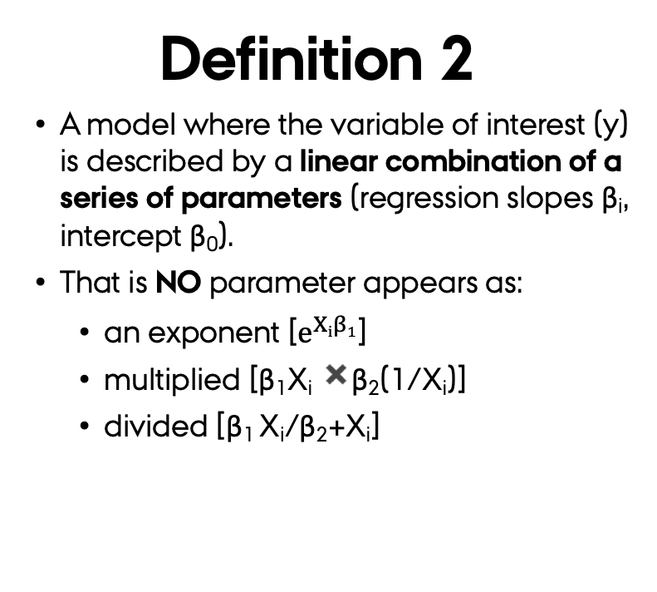
Regression Analysis What does “linear” mean?
Definition 1
A model of a straight-line relationship between the response (y_{i}) and a predictor (β_{i}) variables.
This is the interpretation most biologists are familiar.
Definition 2
A model where the variable of interest (y) is described by a linear combination of a series of parameters (regression slopes β_{i}, intercept β₀).
That is NO parameter appears as:
an exponent [$e^{Xiβ1}$]
multiplied [β₁X_{i} ✖️β₂(1/X_{i})]
divided [β₁ X_{i}/β₂+X_{i}]
The term “linear” refers to the combination of parameters, NOT the shape of the relationship.

Slide 5
Linear models
Nonlinear models

Slide 6
Simple linear regression - elements
The value of Y for the i^{th} observation when the predictor variable X = x_{i}.
The random or unexplained error associated with the i^{th} observation.
Population intercept (mean value of the probability distribution of Y when x_{i}=0).
Population slope and measures the change in Y per unit change in X.

Slide 7
multiple linear regression - elements
The value of Y for the i^{th} observation when the predictor variable X = x_{i.}
Population slope for Y on X₁ holding the other X_{ij} constant.
The random or unexplained error associated
with the i^{th} observation.
Population intercept
mean value of the probability distribution of Y when All X_{ij} = 0.
Population slope for Y on X₂ holding the other X_{ij} constant.
Population slope for Y on X_{p} holding the other X_{ij} constant.

Slide 8
multiple linear regression - elements
Partial Regression coefficients
A measure the expected change in the response variable (Y) associated with a one unit change in an independent variable (X_{i}) holding the other independent variables (X_{j to p}) constant.
Changing which and the number of predictors alters the “relative” effect of these.

Slide 9
So far so good?
Any questions?
Ready to continue?

Slide 10
Linear regression assumptions
Relationship is linear.
Error terms ε_{i} have an equal variance for each x_{ij}.
Observations are independent.
Error terms ε_{i} are normally distributed.
No collinearity between predictor variables.

Slide 11
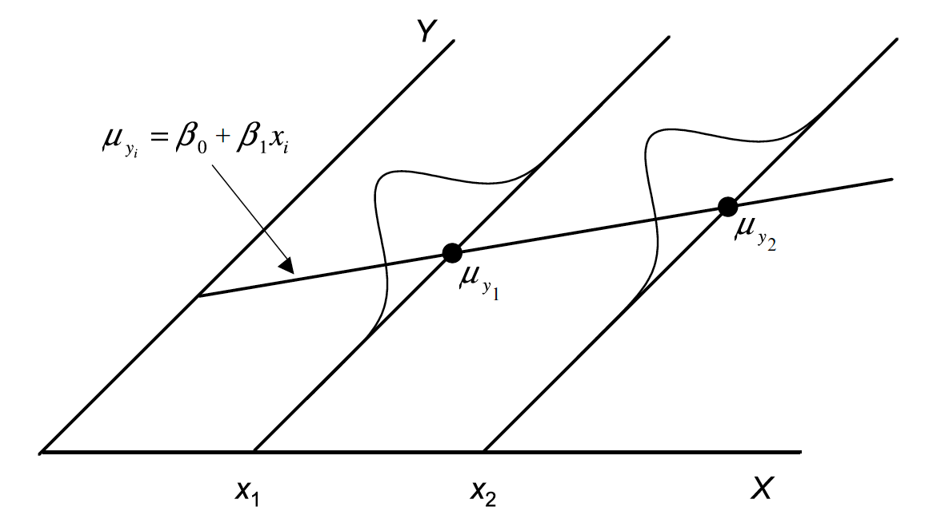
Linear regression assumptions
Relationship is linear
ε_{i} are normally distributed
ε_{i} have
equal variance
Observations are independent

Slide 12
Linear regression assumptions
Questions to ask
Non-linear relation?
Heteroscedastic in the residuals?
Independence of variables?
Non-normal residuals?
Leverage of an observation?
Collinear predictors?
Visual inspection of a object created using the lm function can provide the first pass assessment of these
Important for Multiple regressions

Slide 13
assumptions - Linearity
plot(circumference ~ age,
data = Orange,
pch=19, col= "blue",
main="circumference Vs age",
cex=2,cex.axis=1.5,cex.lab=1.5,cex.sub=1.2,cex.main=2)
Loess.1 <- loess(circumference ~ age,data = Orange)
lines(x=seq(118,1582, by=2),
y=predict(Loess.1,
data.frame(age = seq(118,1582, by=2)),
se = F),
lwd=2,col="red")
WHAT ARE WE TESTING?
Is the the relationship between dependent and independent variables is additive?
The base model
circumference ~ age
For this we use the model equation and exploratory analyses.

Slide 14
assumptions – Homoscedasticity - 1
WHAT ARE WE TESTING
Is the error terms the same across the same across all values of the predictions of the model?
We see Homoscedasticity if the residuals appear to form an equal spread around the horizontal line without distance patterns.

Slide 15
assumptions – Homoscedasticity - residual plots
Residual plot
The most useful figure to test regression assumptions
As it helps detecting, heterogeneity of variances, non-linearity, and autocorrelation.
(standardized)
residuals e_{i}
If the assumptions are met,
the residuals will look like an unstructured cloud of points.
predicted (fitted) values

Slide 16
assumptions – Homoscedasticity - residual plots
(standardized)
residuals e_{i}
(standardized)
residuals e_{i}
predicted (fitted) values
predicted (fitted) values
If the assumptions are NOT met
The residuals will look like a structured cloud of points.

Slide 17
assumptions – Homoscedasticity - 2
WHAT ARE WE TESTING
Are the standardized error terms the same across all values of the predictions of the model?
When using the Sqrt of Standardized residuals what we DO NOT want to see is a triangular shape.

Slide 18
assumptions - Independence
This figure looks the same as a residual plot
WHAT ARE WE TESTING?
Is there a pattern in the residuals as a function of the predictor?
As for Homoscedasticity, we are looking for no relation between these residuals and predictors.

Slide 19
assumptions - Normal distribution
WHAT ARE WE TESTING
Do the residual error terms meet the assumption of normal distribution?
The residuals are normally distributed if they are in a straight line.

Slide 20
Solving problems with assumptions: Transformations
power (e.g. square-root).
Logarithmic (e.g. L_{n} or Log₁₀).
Logit.
arcsin square-root.
Box-Cox
Proportion data
Why transform?
to reduce or remove non-normality, non-linearity, heteroscedasticity.
What to transform?
You manly want to transform your response variable.

Slide 21
So far so good?
Any questions?
Ready to continue?

Slide 22
Multiple regression assumptions – Multicollinearity
WHAT ARE WE TESTING?
Are some predictors strongly correlated?
We have collinearity if one predictor can be predicted based on the others with a substantial degree of accuracy.

Slide 23
Multiple regression assumptions – Multicollinearity
WHY THIS IS A PROBLEM?
Inflate standard errors of partial regression coefficients.
Partial regression coefficients change erratically by adding or removing a variable.
Multicollinearity refers to individual predictors
NOT
the reliability of the model as a whole.

Slide 24
Multiple regression assumptions – Multicollinearity
Testing for multicollinearity involves assessing the redundancy of predictors via …
Pairwise correlations
X_{i} ~ X_{j}
Tolerance / Variance inflation
X_{i} ~ X_{j} + X_{k} + …+ X_{n}

Slide 25
Multiple regression assumptions – Multicollinearity
Pairwise correlations
A rule of thumb is that values above 0.7 are strong correlations and hence imply strong Pairwise collinearity.

Slide 26
Multiple regression assumptions – How to estimate Tolerance?
Is estimated by modelling each predictor as a function of all other predators.
X_{i} ~ X_{j} + X_{k} + …+ X_{n}
The Tolerance for of each predictor is based on this regression and estimated as: 1 − R^{2.}
Values below 0.1 are problematic.
The inverse of the Tolerance is called Variance inflation index.

Slide 27
Dealing with collinearity
Simplest solution: Remove redundant variables.
Principal components regression: use the PCA-axes from the correlation matrix of the predictor variables as predictors ➔ Issue: How to read the partial regression coefficients?
Ridge regression: small biasing constant is added to the normal equations that are solved to estimate the standardised regression coefficients ➔ TO COMPLEX so avoid it.

Slide 28
So far so good?
Any questions?
Ready to continue?

Slide 29
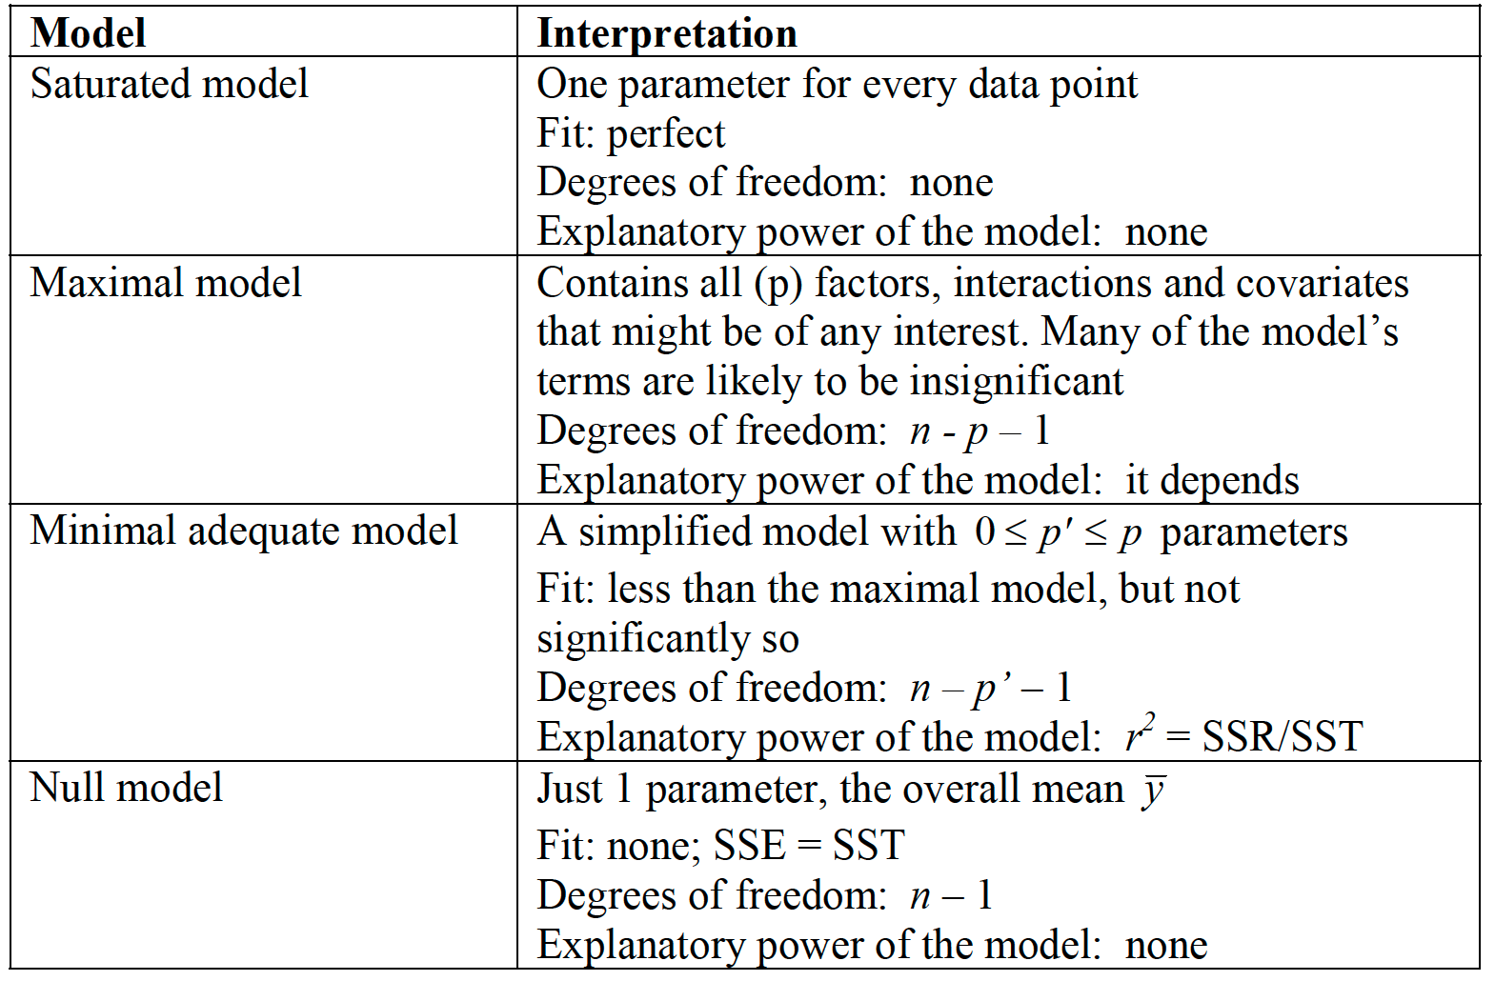
Model selection – Key terminology

Slide 30
DO I NEED this VARIABLE? - Simple
Call:
lm(formula = Ozone ~ Solar.R + Wind + Temp, data = airquality)
Residuals:
Min 1Q Median 3Q Max
-40.485 -14.219 -3.551 10.097 95.619
Coefficients:
Estimate Std. Error t value Pr(>|t|)
(Intercept) -64.34208 23.05472 -2.791 0.00623 **
Solar.R 0.05982 0.02319 2.580 0.01124 *
Wind -3.33359 0.65441 -5.094 1.52e-06 ***
Temp 1.65209 0.25353 6.516 2.42e-09 ***
---
Signif. codes: 0 ‘***’ 0.001 ‘**’ 0.01 ‘*’ 0.05 ‘.’ 0.1 ‘ ’ 1
Residual standard error: 21.18 on 107 degrees of freedom
(42 observations deleted due to missingness)
Multiple R-squared: 0.6059, Adjusted R-squared: 0.5948
F-statistic: 54.83 on 3 and 107 DF, p-value: < 2.2e-16
Q1: Is predictor effect significant?
Only keep variables with significant effects

Slide 31
DO I NEED this VARIABLE? - Complex
Step 1: Omit one variable (X_{j}) or a group of variables (X_{j} to X_{n}) from the model.
This is the reduced model, with n − 1 predictors.
Step 2: Compare the reduced model with a full model.
The full model has all the predictors.
You will use either:
A log-likeihood procedure to assess if there is information gain.
A performance metric to assess if adding a variable inprioved prediction performance

Slide 32
Model selection
The goal is to:
Define which combination of predictor variables (and their interactions) is the best model.
Important principles:
Occam's razor – keep it simple (avoid overfitting)
Type I error – chance goes up with multiple testing
Common sense – model selection is an 'art’

Slide 33
Model selection Forward procedure
Forward selection (addition)
Start with only most significant predictor in the regression model (lowest P)
Out of remaining predictors? → include the one which best explains residual variation (lowest P)
Out of remaining predictors?… etc.
STOP when no further predictors significant

Slide 34
Model selection Backward procedure
Backward selection (elimination)
Start with all predictors in the regression model
Remove the least significant predictor (highest P in a partial F test), if non-significant
remove next least significant predictor… etc.
STOP when all remaining predictors significant

Slide 35
Model selection stepwise procedures
Stepwise selection (addition then elimination)
Proceed as in forward selection ➔ adding new predictors
Proceed as in forward Backward selection ➔ remove predictors that are no longer significant
STOP when all predictors in model are significant and all those left out are not

Slide 36
So far so good?
Any questions?
Ready to continue?

Slide 37
Importance of predictors
Only a qualitative assessment - ranking NOT how much will the response change by the increase of one unit in the predictor.
How important is predictor X_{j}?
Look at P value from t -test or F- test
(correct for multiple testing…?)
Look at the standardised effect size
standardised partial regression coefficient:
Now the coefficients is measured in units of SD
Independent of scale of measurement

Slide 38
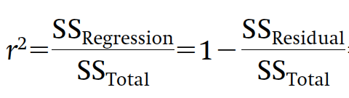
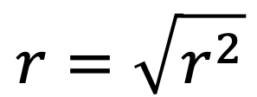
How good is my model?
Coefficient of multiple determination:
Proportion of the variance explained by regression model.
Multiple correlation coefficient:
$$r=\sqrt{r^{2}}$$
Between y and all x_{j}
Pearson’s R

Slide 39
How good is my model?
Adjusted R²
Penalises the R² value based on the number of predictors
Mallow’s C_{p}
Contrast based on the Sum of Squares between full and reduced model
AIC or BIC
Contrast the information in the full and reduced model

Slide 40
So far so good?
Any questions?
Ready to finish?

Slide 41
Summary
The term “linear” refers to the combination of parameters, not the shape of the relationship.
Always test of the assumptions to define if the linear model you build is “statistically correct”.
If you have multiple variables ➔ Check for collinearity and only retain meaningful variables.
Always build the Minimum Adequate Model (MAM) based on a model selection procedure.
For contrasting the “relative” effect of each variable use standardised regression coefficients.

